Slide 1
Air Quality in the Continental US
By Andrew Oliver, Raymond Xu, Sahej Singh, Kamron Ramelmeier, and Alexander Chen

Slide 2

Table of Contents
Introduction
Data Cleaning
EDA
Impact of 2017 Climate Alliance
Factors of AQI
Models
Conclusion

Slide 3
Introduction
OBJECTIVE:
Examine the impact of variables on the climate
by examining the AQI of states across the United States of America using data collected by the EPA.
Part 1: Examine the effects of the Climate Alliance legislative program
Part 2: Examine the correlation between aspects of states and the air quality.

Slide 4
Data Cleaning

Slide 5
Data Cleaning
Drop extraneous variables or variable values
Ie. Drop data for “Country of Mexico” or “UnempRate.1920”
Convert relevant frequencies to percentages
Combine separate datasets from 2010 to 2020
Manually prepare (using online reference) column describing “Climate Pledge” status for states

Slide 6
EDA

Slide 7
Average AQI by State

Slide 8
Average AQI by State: Relative

Slide 9
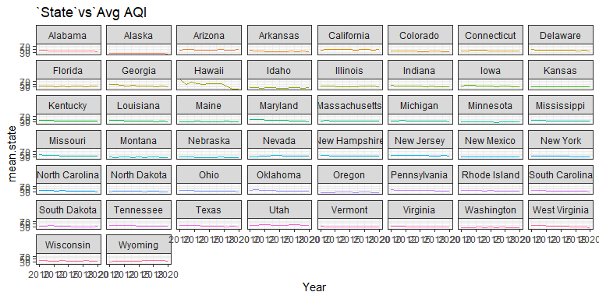
Causes of Climate Change

Slide 10
Climate Alliance

Slide 11
Linear Model
We attempt to predict median AQI using climate allegiance status and state. We also exclude 2020 to avoid skewing due to 2020 West Coast fires.
Residuals
Min: -36.82 | Q1: -3.06 | Median: 1.47 | Q3: 5.68 | Max: 94.52 | SE: 10.6
R-squared: 0.171

Slide 12
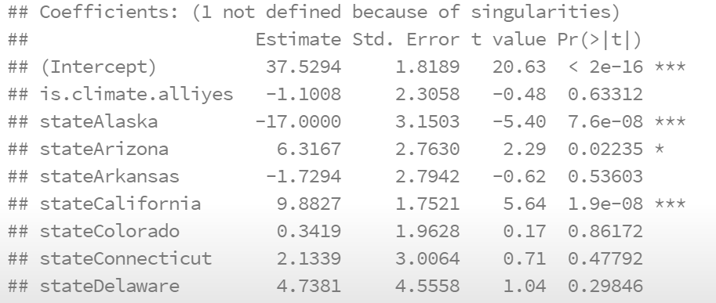
Linear Model

Slide 13
Looking at the predicted AQI’s:
Climate Alliance states do tend to have higher AQI on average. However, it is insignificant
We conjecture this is because the Climate Alliance only went into effect 3 years ago

Slide 14
County Level Effects on AQI
Using data from the USDA’s Economic Research Service, we look for predictors in counties to determine air quality and find correlations

Slide 15
Data Cleaning
We use 2019 data to avoid skewing due to 2020 West Coast fires.
Break the previous cleaned dataset into X (explanatory variables) and Y (AQI) for use with cv.glmnet()
Remove unhelpful variables and duplicates.
“NumUnemployed” when we have “PctUnemployed”

Slide 16

LASSO

Slide 17
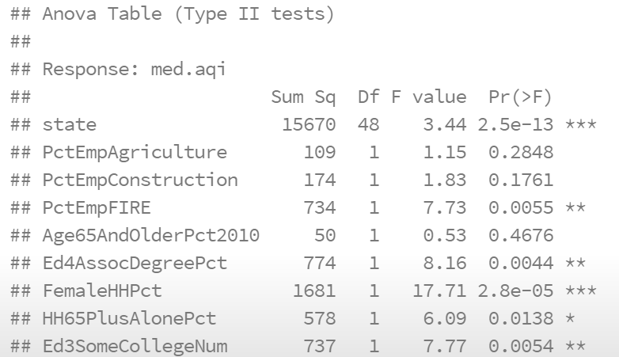
Anova

Slide 18
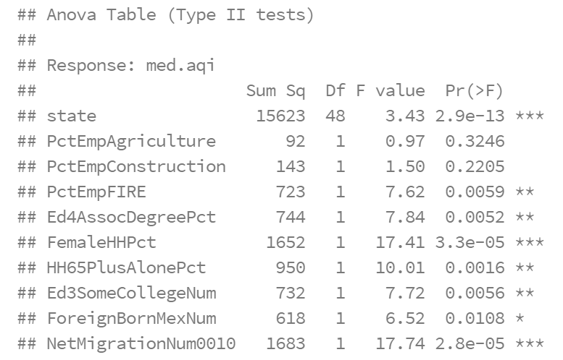
Anova iter. 2

Slide 19
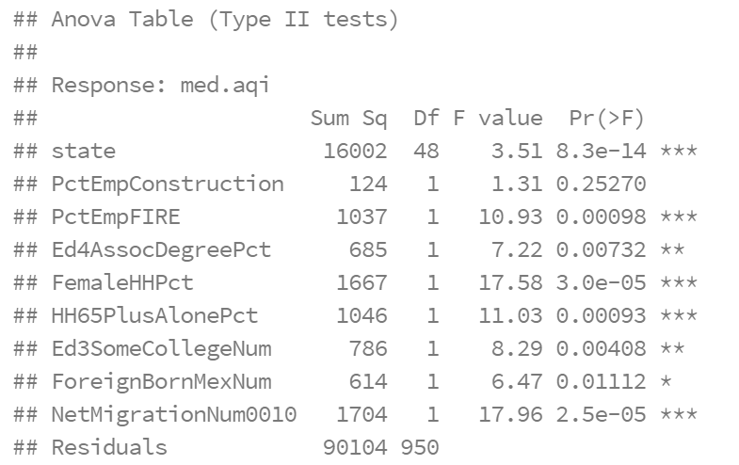
Anova iter. 3

Slide 20
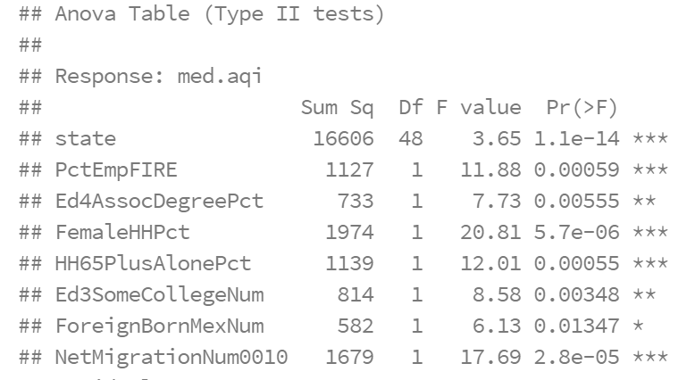
Anova iter. 4: Final

Slide 21
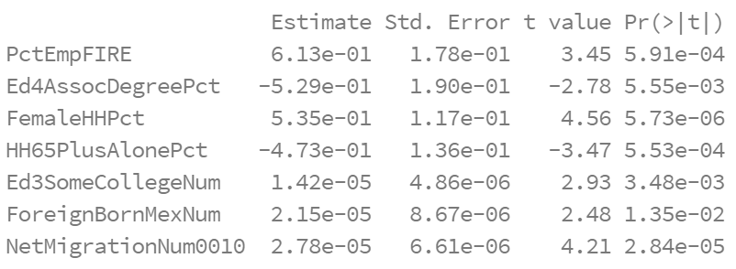
Final Model
Model MSE: 89.6
Null MSE: 128
Majority impact geographical
States themselves = deciding factor
ForeignBornMexNum and NetMigrationNum could signal proximity to Mexican border = factor.

Slide 22
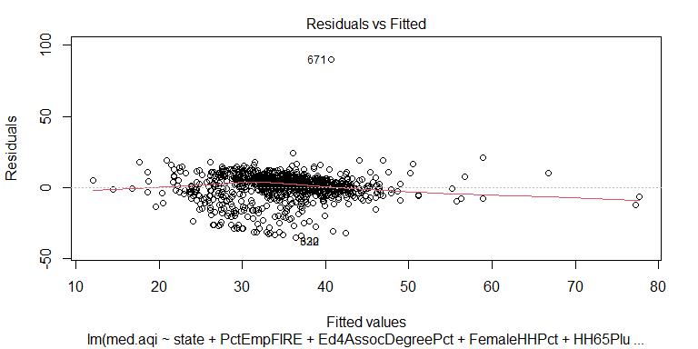
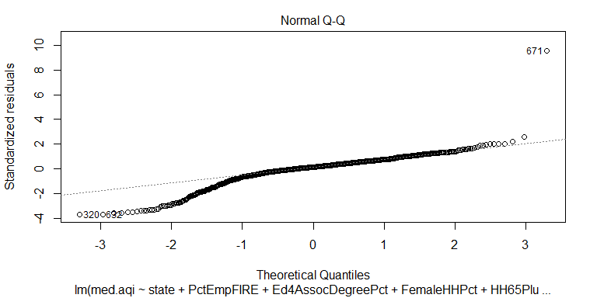
Assumptions for linearity...
Appear to be met up until about 1 standard deviation below the mean

Slide 23
Random Forest
We take two samples of the same data used in the linear model
sample(2, nrow(lm_cols), replace = T, prob = c(0.7, 0.3))
Split data into train and test
Set seed for consistency
Attempt to optimize for mtry

Slide 24
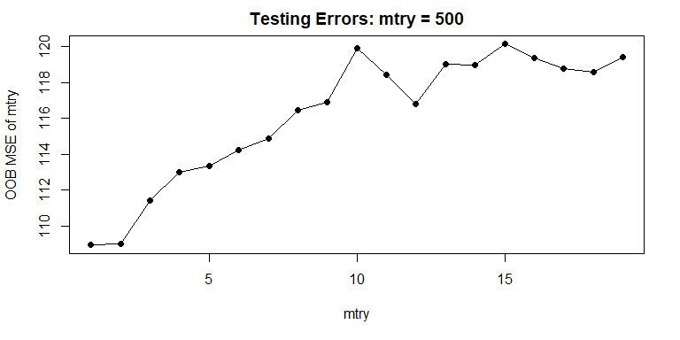
It appears that mtry = 1 would be a good value

Slide 25
RF Model
randomForest(med.aqi~., train, mtry=1, ntree=500)
Use to predict training data
Model MSE = 25.7
Much better than linear model!
Use to predict test data
Model MSE = 136.9…
Importance plot reveals state to be the most important var

Slide 26
Conclusions

Slide 27
Conclusions
The overall objective was to use the AQI of states across the USA to determine the impact of variables on the climate.
We were able to conclude that
The Climate Alliance has not had much of an effect yet on the AQI of member states, but do have a higher average, though statistically insignificant
Most of the impact on the AQI is geographical based on the significant variables in both LASSO and RF

Slide 28

Thank You!

